Slide 1

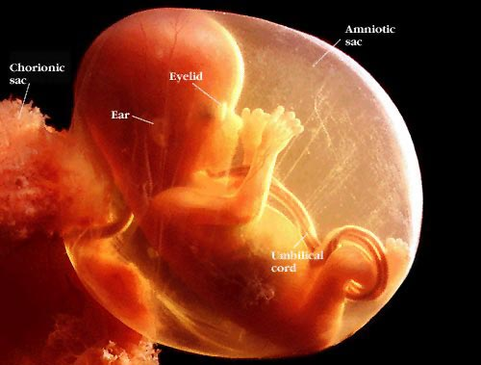
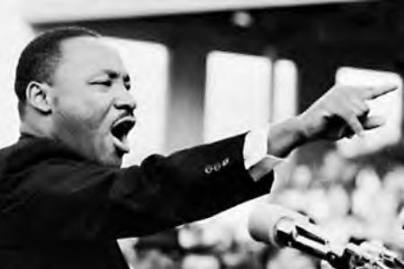

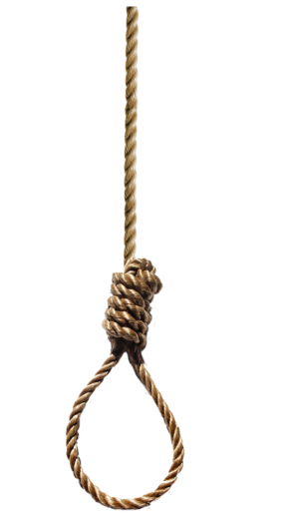




GCSE R.S.
What do we study in GCSE R.S?
Why do we do it?
How can it help me?

Slide 2
GCSE R.S. - Why do we do it?
  Core R.S. is a legal requirement in every school in the UK
  We think – if you have to sit in an R.S. classroom, you should get a qualification in it

Slide 3

GCSE R.S. – how can it help me?
Get the grade:
For many students at Thirsk, their GCSE grade in RS is either their best grade or equal best
Try hard, do well. Simple!
Last year (2023), more students at Thirsk got a good pass (level 5 or above) in RS than in any other core subject – English, maths or science
A good grade in R.S. could help you get:
An apprenticeship
Into 6th form college at Thirsk
Into a different college (Askham Bryan, Harrogate, York, Darlington, Northallerton and many more)

Slide 4

GCSE R.S. – how can it help me?
2. Explore the ultimate questions
As well as a great chance of a good grade, in RS you also explore many of the issues and challenges that life inevitably involves:
Is the death penalty right?
Is there any life after death?
Is it ever right to go to war?
Should euthanasia be legalised?
96 % of year 11 said RS was “worthwhile and useful for life”, regardless of whether they are religious or not.

Slide 5
What do we study?
Your AQA GCSE RS involves 8 topics
Religion:
Christian beliefs
Christian practices
Buddhist beliefs
Buddhist practices
Themes
Human rights & Equality
Life: abortion, euthanasia & animal testing
War & Justice
Crime & Punishment
There is no coursework. You will sit 2 exams at the end of year 11
Why this course?
We have to teach the Christian units – plus you will probably know quite a bit of this already
We asked students what they wanted to learn about for the 2nd religion – Buddhism was the clear winner.
Past students said the 4 themes we have chosen were their favourites.

Slide 6
GCSE RELIGIOUS STUDIES
In summary:
RS is a core subject – all students take a full GCSE in it
There is no tiered paper – all students can attain the full range of grades
There is no coursework – it is assessed by exams at the end of year 11
The current syllabus is AQA: Philosophy and Ethics – Christianity & Buddhism
We have to study Christianity – this is a legal requirement.
We chose Buddhism in response to overwhelming feedback from student surveys
The course involves the study of Christianity and Buddhism, and 4 thematic units:
  Equality & Human Rights
  War & Justice
  Crime & Punishment
  Life (abortion, & euthanasia)
Our students consistently gain excellent results. In 2019 more students gained a level 5 in RS than in any other core subject. This helped them achieve their post-16 goals
Any questions? Contact your RS teacher.

